Slide 1
Drupal
Content Management System
Drupal
Online Environment
Content
Supporting Personal and Collaborative
Online Environments
2007 IST Conference - Indiana University
Jennifer Maddrell
March 2, 2007
Notes:
Overview
This presentation highlights the use of the Drupal content management system to support personal and collaborative online environments. Drupal is open source web based software that facilitates web site development and online content management. The presentation will provide a high level overview of available features and processes involved with Drupal based web site development, data creation, content storage and information sharing within personal and collaborative learning environments.
Target Audience for Workshop
The target audience for this workshop includes those who are unfamiliar with Drupal, but are interested in creating, supporting or using a personal or collaborative online environment.
Note: To link to the web sites referenced in the notes section, highlight the text, right click and select “Open Hyperlink”.

Slide 2
Workshop Agenda
Drupal at a Glance
Web Site Development Using Drupal
Online Content Management
Drupal Online Spaces in Action
Getting Started with Drupal
Notes:
In this presentation we will see how an online environment can be supported by using a Drupal based web platform populated with user generated (or collected) content. At the conclusion of the workshop, attendees will be able to:
Describe the basic aspects of Drupal web site development,
Identify the key content management capabilities of a Drupal based web site,
Review examples of Drupal based online environments,
Complete the steps necessary to begin a basic Drupal installation.
We begin by examining the Drupal web development software …

Slide 3
What is Drupal?
Web based software application
  Web site development software
  Content management focus
  Open source code
  Free to use, modify and share
  Subject to Drupal License (GNU GPL) → link
Software development project
  Community of volunteer developers and users
  Agree to adhere to general principles → link
  Under guidance of Drupal Association (new)
Notes:
Drupal is both a web site development application, as well as an ongoing software development project managed and maintained by a volunteer community of software developers and users. The software application provides streamlined web site development and web based content management. Drupal is open source software which means that the software source code is shared by the individuals who created it. Developers on the Drupal project agree to adhere to general principles and conditions laid out by the project’s founders – see http://drupal.org/principles - and to make the core software available to users free of charge, subject to the GNU General Public License (GPL) – see http://www.gnu.org/licenses/gpl.html . These individuals have formed a large community of independent software developers who also contribute to the ongoing development and support of the software.

Slide 4
Why use Drupal?
Ease of use
  Rapid “plug and play” web site development
  Built in collaboration tools and features
  Online web site administration and control
Vast array of web site configuration options
  Hundreds of contributed modules and themes
  Ability to modify and customize the software code
Efficient online content management
Large and active community → link
Notes:
If Drupal is simply web development software that provides a means of storing content online, why use Drupal instead of other web development options? The short answer is ease of use. Drupal software provides an simple (plug and play) means of rapidly developing a robust personal or collaborative web site. By simply installing and configuring the core software on a web server, users are able to instantly create an online environment.
In addition to installing the core software, users have access to hundreds of contributed models and themes that provide the primary web site developer, designated web site administrators and assigned end users the ability to easily add or modify web site content directly from the web based interface. Users also have the ability and flexibility to get behind the scenes and tweak the software code as their web development skills allow. In addition, the large and vibrant community provides peer support to both users and developers and fosters the ongoing open source development of the Drupal project – see http://drupal.org/community.

Slide 5
Web Site Development
Site Installation
  Upload Drupal software to server
  Configure database
Site Administration
  Web based control panel
  Administrative access controls
Site Customization
  Modules: Features and functionality
  Themes: Layout and design
Notes:
The following highlights the basic installation, administration and customization processes involved with developing a web site using the Drupal software:
Installation: The Drupal installation process includes downloading the required free software from the official Drupal site at http://www.drupal.org/. The software containing the core web site framework must be uploaded to a web server. The database which stores most of the content on the web site must be configured as instructed within the Drupal software installation package.
Administration: Site administration and access to the web site’s features is handled through an administration control panel on the web site. Based on the access controls and privileges granted to the various user types, the web site’s ongoing administration can be handled by any number of individuals.
Customization: Customization possibilities are enhanced via configuration of the core Drupal software, as well as through installation of additional software upgrades in the form of modules and themes.
Modules developed and contributed by the open source developers expand the features and functionality of the Drupal software – review module examples at http://drupal.org/project/modules.
Themes enhance the layout and design of the web site – review theme examples at http://drupal.org/project/themes.

Slide 6
Online Content
e-books
web sites
books
tv shows
podcasts
e-mails
instant messages
news
reports
papers
movies
journals
music
blogs
letters
Notes:
In this digital age, we are all faced with various forms of online content, such as podcasts, e-mails, blogs, e-books and web pages. We are challenged to figure out:
What is the best way to create and store this digital content for use in the future?
How can the content be indexed to build a personal or group repository of knowledge and information?
Beyond storage, how can we grow and learn from the information and content that we create and encounter?
Are there ways to collaborate and share information with others?

Slide 7
Drupal Online Environment
make
showcase
express
reflect
collaborate
gather
organize
Notes:
Drupal provides as answers to these questions. Drupal is designed to manage content within an online environment. Think of it as an efficient means of juggling all of the balls of content illustrated on the previous slide. The formation and maintenance of an online environment is a way to not only manage the content we create and receive, but to also build an online environment that fosters reflection, expression and collaboration with others.

Slide 8
Drupal Content Management
Content
Create
Share
Index
Notes:
As illustrated in this diagram, Drupal manages content within an online environment in three primary ways. It provides an array of options to (1) create, (2) index and (3) share user generated or collected content. The next few slides illustrate these content management processes.

Slide 9
Create
blog
book
podcast
image gallery
video display
Notes:
Drupal ‘s content creation options support reflection, exploration and collaboration within an online environment. Modules are available to facilitate the creation of many forms of content, including blogs, books, podcasts, image galleries and video displays. These content creation features are referred to within Drupal as “nodes” – see examples at http://drupal.org/node/21947.

Slide 10
Index
web resources
tags
digital
files
links
menus
Notes:
Drupal includes many options to store and index content. Digital files, such as text, audio, picture and video files, can be uploaded to the site. Links to web resources can be incorporated into navigation menus – see http://drupal.org/handbook/modules/menu. Drupal also provides a robust classification (or taxonomy) system which allows content to be organized and “tagged” for future retrieval – see http://drupal.org/node/299.

Slide 11
Share
RSS
feeds
surveys
and polls
comment
discuss in forums
collaborate
Notes:
Drupal includes options to share content with others. Drupal has a robust RSS 2.0 feed generator that arranges content in a manner that can be read by others in a program referred to as a feed reader or feed aggregator. As new content is added to the Drupal site, the RSS feed containing the new content is automatically updated. Others who have set up their feed readers to subscribe to the feed will see the new content within their feed reader. In addition, registered users and visitors with access to the site can share ideas, provide feedback and work on projects by using a variety of collaboration features as in comment, book, discussion forum, survey and poll tools.

Slide 12
Drupal Online Spaces in Action
Personal Space
Blog
Portfolio
Community Space
Conference
Web Cast Platform
Learning Environment
Discussion
Audio
Video
Lessons
Resources
Blog
Portfolio
Conference
Discussion
Audio
Video
Lessons
Resources
Notes:
We will now look at the Drupal software and content management features in action within working online environments. This is likely the best way to appreciate the features and functionality of Drupal. The linked web sites highlight ways in which Drupal’s features support both personal and online environments:
Personal Space: Drupal’s core features can facilitate a personal online space:
Dries Buyheirt (founder of Drupal) at http://buytaert.net/ - see the use of blog posts.
Designed to Inspire at http://designedtoinspire.com/drupal/portfolio- see the use of content creation and storage options to create a personal portfolio space.
Community Space: With the ability to allow multiple user access and control over the site’s content management, Drupal provides an excellent platform for community spaces.
New York City Independent School Technologists at http://www.nycist.net/ - see the use of collaborative blogging and the integration of third party tools -http://www.nycist.net/d/node/36.
Women of Web 2.0 at http://www.womenofweb2.com/?q=forum - see the use of discussions.
Podcasting Platform: With the ability to upload, store and share video and audio via RSS feeds, Drupal provides an excellent podcasting platform.
EdTechTalk.com at http://edtechtalk.com/ - see the use of audio sharing.
Lullabot.com at http://www.lullabot.com/videocast - see the use of video sharing.
Learning Environment: Groups like Open Academic at http://openacademic.org/ hope to integrate Drupal with course management systems, such as Moodle. However, as a standalone installation, Drupal is well suited to facilitate an online learning environment.
Webcast Academy at http://webcastacademy.net/ - see the use of groups (or classes).
Drupal CMS Academy at http://cmsacademy.net/drupal/class- see the use of book features.

Slide 13
Getting Started with Drupal
Download Drupal software
  Core Software → link
  Modules → link and Themes → link
Install and configure site and database
  Drupal.org Handbook installation guide → link
  Lullabot.com installation videos → link
Access Drupal community resources
  Official Drupal.org support → link
  Drupal.org community page → link
  Drupal CMS Academy → link
Notes:
While it is beyond the scope of this workshop to detail Drupal web site development, the following resources provide guidance on how to get started with a basic Drupal installation:
Download the Drupal software at
http://drupal.org/project/Drupal+project.
http://drupal.org/project/modules
http://drupal.org/project/themes
Follow the installation and configuration instructions in the following resources:
Installation guide at http://drupal.org/node/258.
Installation video at http://lullabot.com/videocast/installing_drupal_5.
Access Drupal community resources for support help and suggestions on how to customize the core installation. There is a large and vibrant community that advances the development and use of Drupal and includes the following community based support resources:
The official Drupal support site at http://drupal.org/support.
Drupal Community see http://drupal.org/community including
Groups.Drupal.org at http://groups.drupal.org includes hundreds of special interest groups that collaborate on Drupal related projects within this online community space.
Drupal.org/planet at http://drupal.org/planet provides a vetted aggregation of feeds from dozens of blogs focused on Drupal development.
The Drupal CMS Academy at http://cmsacademy.net/drupal/. This free collaborative learning environment provides live weekly web casts and links to vetted Drupal recourses.

Slide 14
Web Page Screen Shots
The remaining slides are web page screen shots of linked web sites referenced in the presentation.
Notes:
Screen shots are to be used when an Internet connection is not present to view the linked web sites.

Slide 15
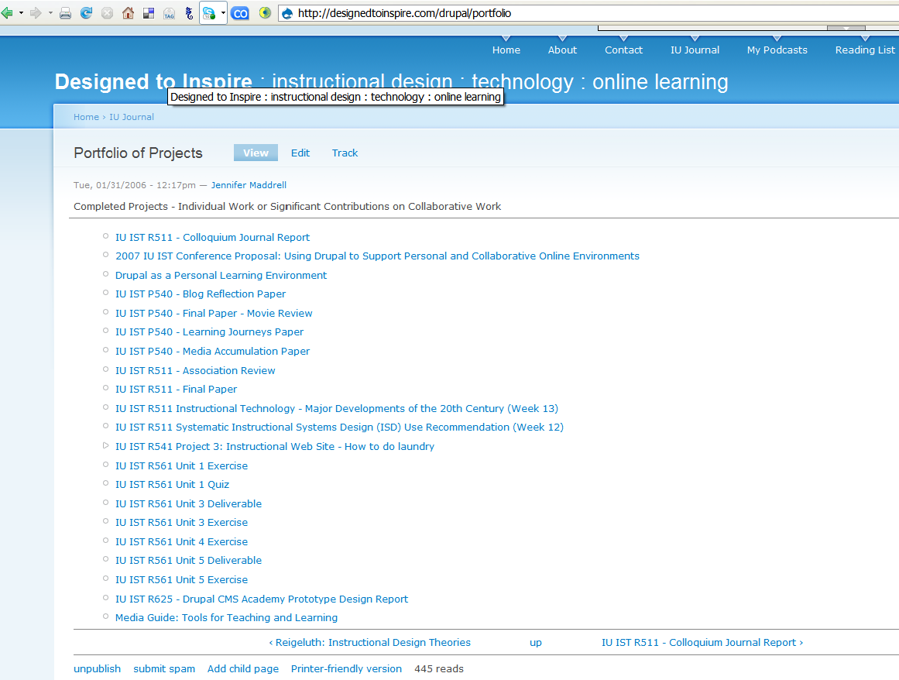
Portfolio Web Site : http://designedtoinspire.com/drupal/portfolio
Notes:
Personal Portfolio Space – Jennifer Maddrell
Web Site: http://designedtoinspire.com/drupal/portfolio

Slide 16
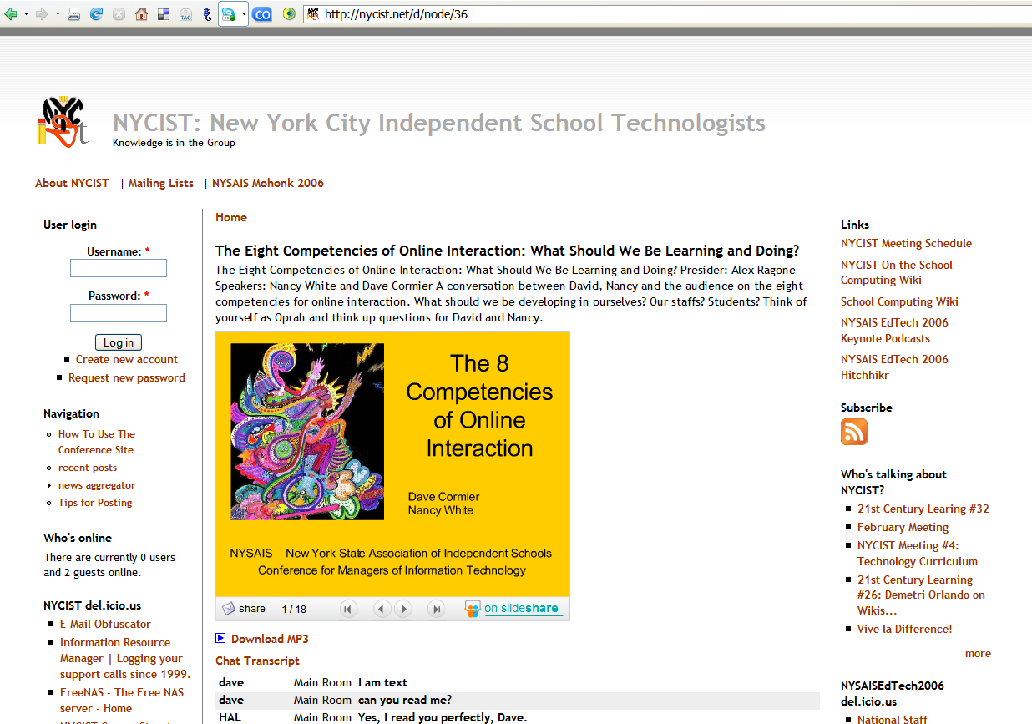
NYCIST Conference Site Web Site : http://nycist.net/d/node/36
Notes:
Group Conference Site – New York City Independent School Technologists
Web Site: http://nycist.net/d/node/36

Slide 17
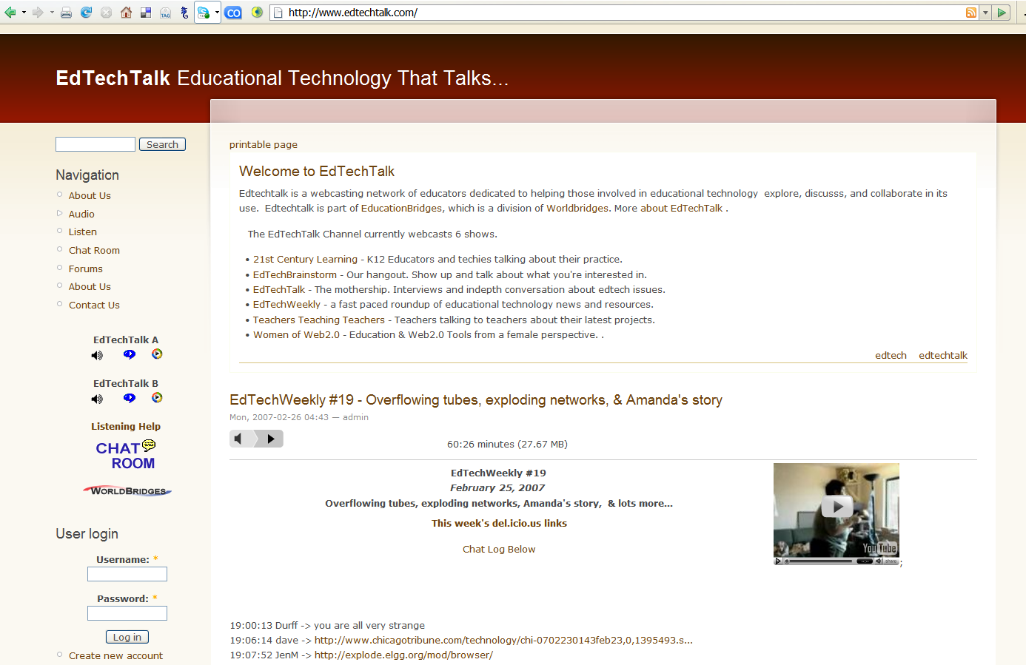
Web Cast Platform Web Site : http://www.edtechtalk.com/
Notes:
Web Cast Platform – EdTechTalk.com
Web Site: http://www.edtechtalk.com

Slide 18
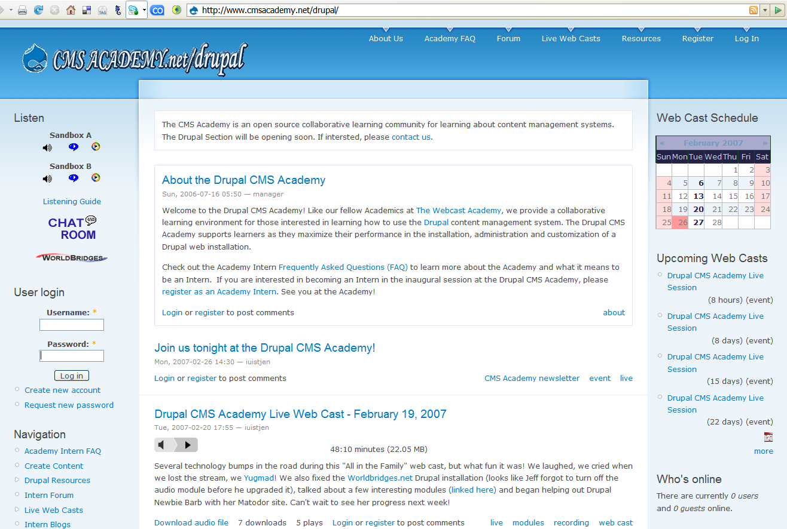
Learning Environment Web Site : http://www.cmsacademy.net/drupal/
Notes:
Online Collaborative Learning Environment – CMS Academy.net/drupal
Web Site: http://www.cmsacademy.net/drupal/

Slide 19
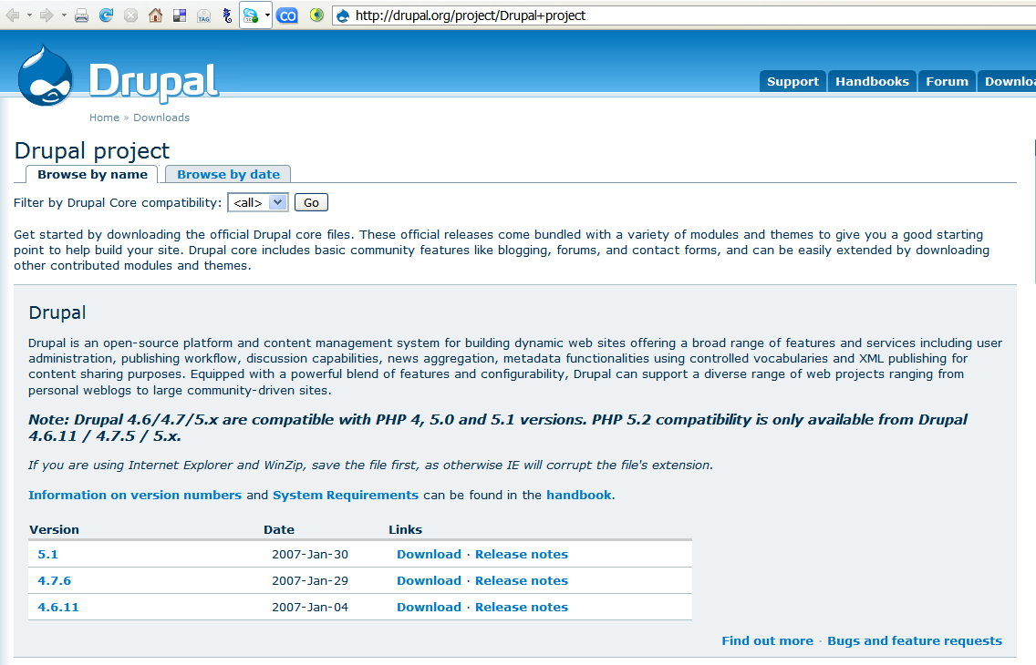
Download Drupal Software Web Site : http://drupal.org/project/Drupal+project
Notes:
Download Drupal Software – Drupal.org
Web Site: http://drupal.org/project/Drupal+project

Slide 20
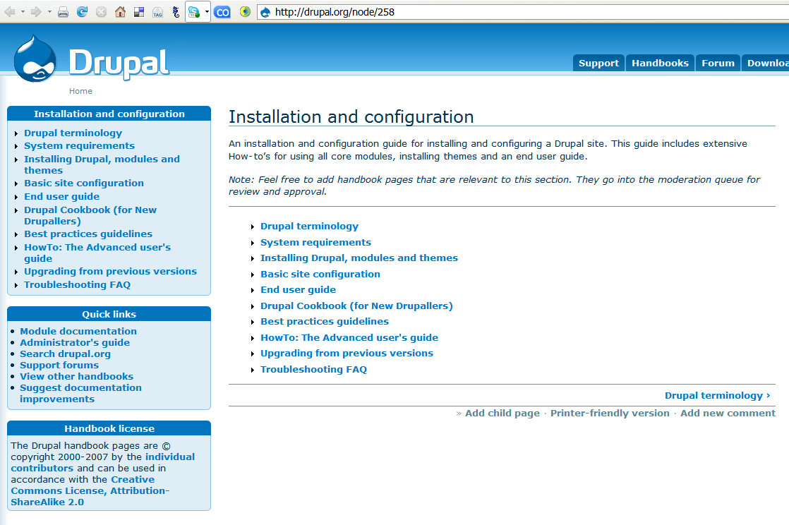
Drupal.org Handbook Web Site : http://drupal.org/node/258
Notes:
Drupal.org Handbook – Drupal.org
Web Site: http://drupal.org/node/258

Slide 21
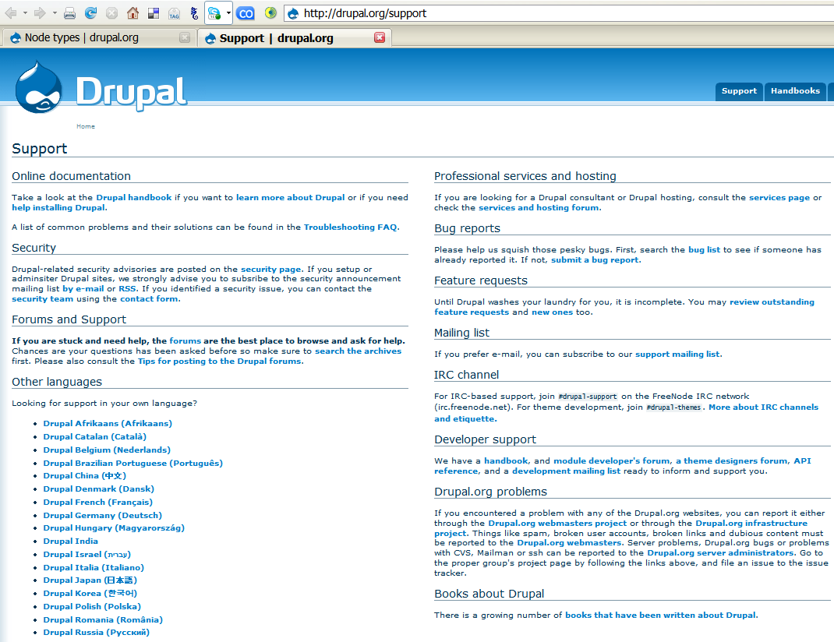
Official Drupal.org Support Web Site : http://drupal.org/support
Notes:
Official Drupal.org Support – Drupal.org
Web Site: http://drupal.org/support

Slide 22
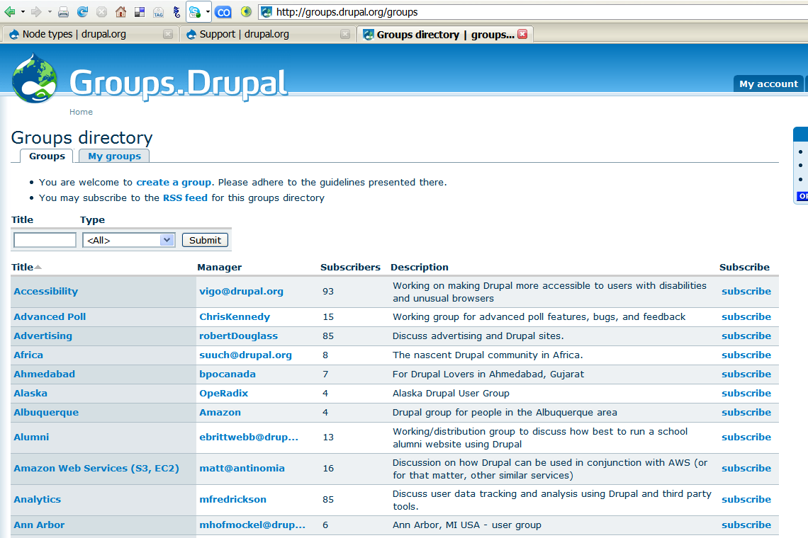
Special Interest Groups Web Site : http://groups.drupal.org/groups
Notes:
Special Interest Groups – Drupal.org
Web Site: http://groups.drupal.org/groups

Slide 23
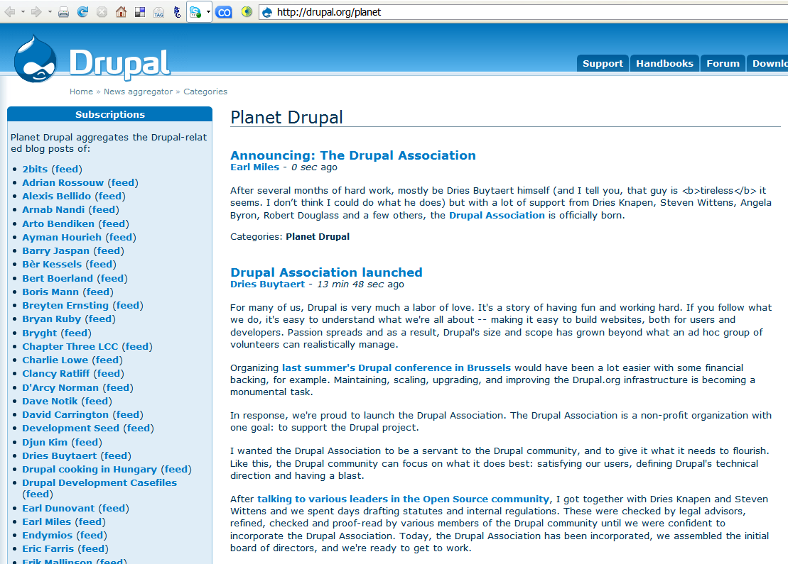
Aggregation of Drupal Bloggers Web Site : http://drupal.org/planet
Notes:
Aggregation of Drupal Bloggers
Source: http://drupal.org/planet

